Slide 1
Chapter 4 Network Layer

Slide 2
N/w Layer Design Issues
Services provided to transport layer
Internal design of the subnet

Slide 3
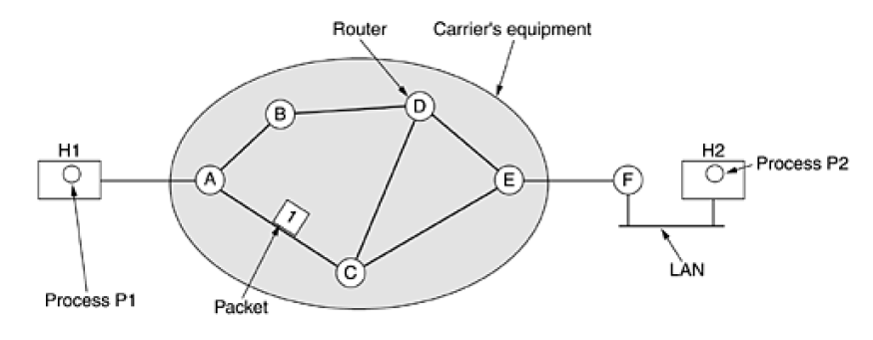
Store and Forward Switching

Slide 4
Services provided to transport layer
3 Goals:
Services should be independent of the router technology
Transport layer should be shielded from the number, type and topology of the routers present
Network addresses made available to transport layer should use a uniform numbering plan, even across LANs and WANs
Notes:
Two types of services: connection oriented : ATM (Asynchronous Transfer Mode)
connection less: Internet

Slide 5
Implementation of connectionless service
Packets subnet individually
routed independently
No advance setup is needed
Packets called datagrams
Subnet called datagram subnet

Slide 6
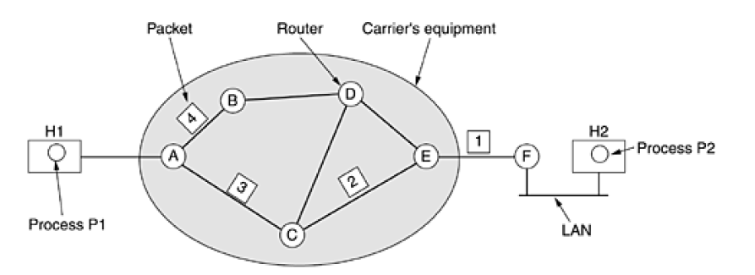
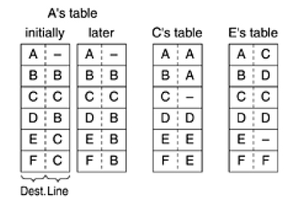

Slide 7
Implementation of connection oriented service
Path from source router to destination router must be established before any data packets can be sent
Virtual Circuit (VC)
Subnet is called virtual circuit subnet

Slide 8
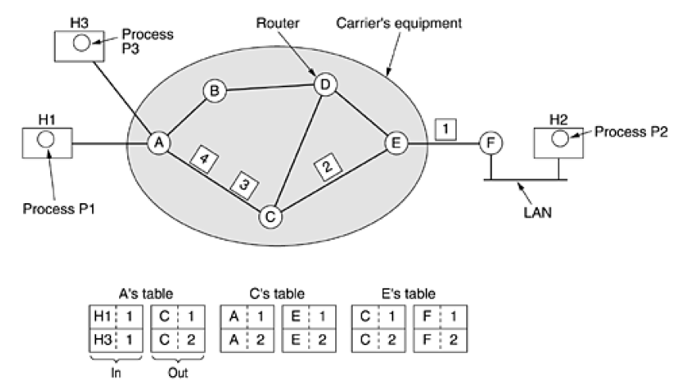
Label Switching

Slide 9
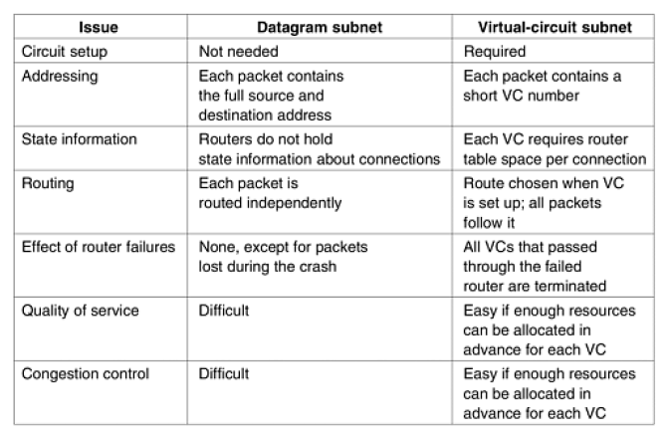

Slide 10
Routing Algorithms
Main function of n/w layer routing packets from source to destination machine
Routing algo n/w layer s/w
Responsible for deciding output line
Datagram new decision
VC use previously established route
session routing

Slide 11
Two process looking up outgoing line (forwarding)
filling in and updating routing tables (routing algo)
Properties of Routing Algo:
Correctness
Simplicity
Robustness
Stability
Fairness
Optimality

Slide 12
2 groups of algo
Static Routing
Do not base routing decisions on traffic & topology
Choice of route computed in advance
Downloaded to router when n/w is booted
Non-adaptive
Dynamic Routing
Change routing decisions to reflect changes in topology or traffic
Get information, change routes, matric used for optimization
Adaptive

Slide 13
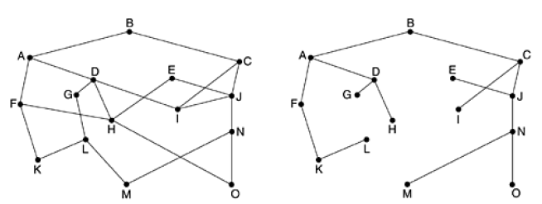
Optimality principle
One can make a general statement about optimal routes without regard to n/w topology or traffic
Optimality Principle
Set of optimal routes from source to destination form tree rooted at the destination sink tree

Slide 14
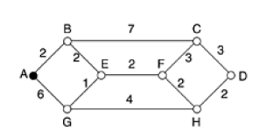
Shortest path routing (Dijkstra)
Measuring Path
No of hops
Length (distance)

Slide 15
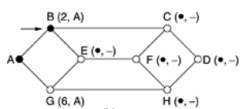

Slide 16
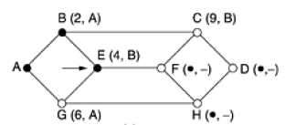

Slide 17
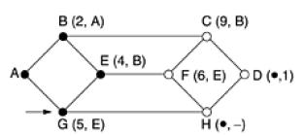

Slide 18
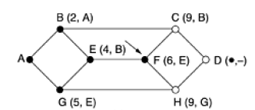

Slide 19
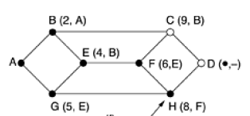

Slide 20
Flooding
Static algorithm
Incoming packet is sent out on every outgoing line
Generate duplicate packets
Hop counter contained in header of each packet
Alternative technique to keep track - list per source router – having sequence number
Selective flooding
Shortest Path algorithm

Slide 21
Applications where flooding is used
Military applications – robustness
Distributed database applications
Wireless networks

Slide 22
Distance vector routing
Dynamic routing
Also known as Bellman-ford , Ford-Fulkerson
Developed by Bellman , ford, Fulkerson
It was original ARPANET routing algorithm and used in internet as RIP ( Routing Information Protocol)
Each router maintains a routing table indexed by, and containing one entry for each router in the subnet

Slide 23
Entry contains two parts:
Preferred outgoing line to use for that destination
Estimate of time or distance to that destination
Count to infinity problem:
Settling of routes to best paths across the network is called convergence
Slow

Slide 24
Link state routing
DV was used in ARPANET until 1979, when it was replaced by LS routing
Each router do following task:
Discover its neighbors and learn their n/w addresses
Set distance to each of its neighbors
Construct a packet telling all it has just learned
Send this packet to and receive packets from all other routers
Compute the shortest path to every other router

Slide 25
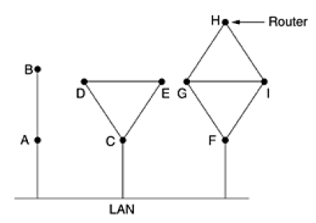
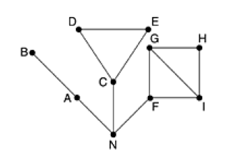
Learning about neighbors
Send special HELLO packet on each point to point line
Router on the other hand reply with its name (unique)

Slide 26
Setting link costs
LS algo requires each link to have a distance for finding shortest path
Cost to neighbors can be set automatically or configured by n/w operator
Cost inversely proportional to bandwidth of the link
For example: 1GBPS => cost is 1
10MBPS => cost is 10
If n/w is geographically spread out, delay of links may be considered into cost of the link
To determine delay send special ECHO packet that other side is required to send back immediately (RTT/2)

Slide 27
Building link state packets
Once info needed for the exchange has been collected, next step is to build a packet containing all the data
Packet start with identity of sender, sequence number and age and a list of neighbors
Cost to each neighbor is also given

Slide 28
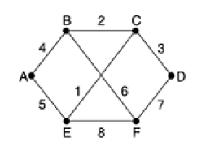
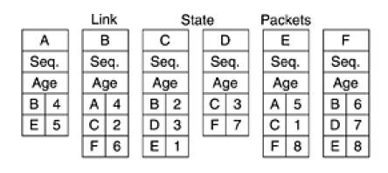
Building of link packet is easy but to identify when to build is difficult
Two possibilities:
periodically
significant event occur

Slide 29
Distributing the link state packets
Trickiest part of algo is distributing link state packets reliably
Flooding is used to distribute
Some problems with algo:
If sequence number wrap around, confusion will reign
solution: 32 bit sequence number
If router crashes, it will lose track of its sequence number

Slide 30
If sequence number is corrupted and 65540 is received instead of 4, packets 5 through 65540 will be rejected as obsolete, since current sequence number is thought to be 65540
Solution: include age after sequence number
decrement it once per second
when it hits 0, info from that router is discarded

Slide 31
Computing new routes
Now Dijkstra’s algo can be used to construct shortest path to all possible destinations
For a subnet with n routers, each having k neighbors, the memory required to store the input data is proportional to kn
OSPF & IS-IS uses link state algo

Slide 32
Hierarchical routing
N/w grows in size, router routing tables grow proportionally
In hierarchical routing, routers are divided into regions
Router knows about its own region but knows nothing about internals of other regions.
Kamoun and Kleinrock discovered that the optimal no if levels for N router n/w requiring a total of e ln N entries per router

Slide 33
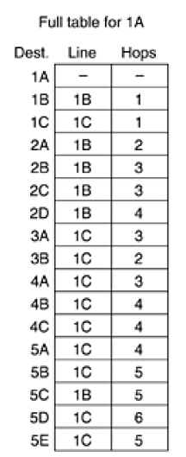
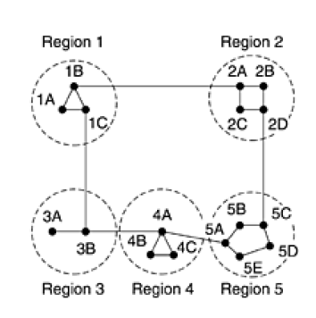
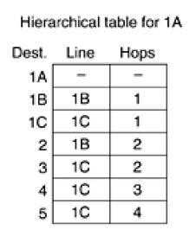

Slide 34
Broadcast routing
Sending a packet to all destinations simultaneously is called broadcasting
Method 1: require no special features
send packet to each destination
waste of bandwidth, slow
require list of all destinations
This method is not desirable in practice

Slide 35
Method 2: Multidestination routing
: Packet contains list of destination or bit map
: N/w bandwidth is used more efficiently
: Source should know all the destinations
: Router to determine where to send one multidestination packet
Reverse Path Forwarding

Slide 36
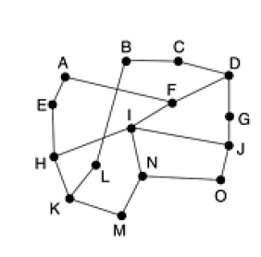
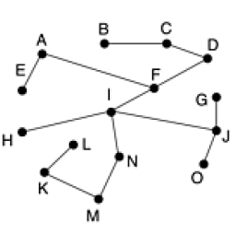
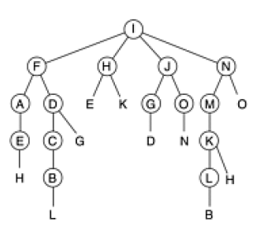
Reverse Path Forwarding
N/w Topology Sink Tree for I Reverse Path Forwarding

Slide 37
Multicast routing
Sending message to such a group is called multicasting and its routing algorithm is called multicast routing
Multicasting requires group management
When a process join group, routing algo informs its host
Either host inform to group members or routers query their hosts periodically
Routers learn about group of hosts and tell their neighbors in the subnet

Slide 38
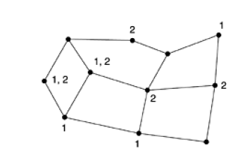
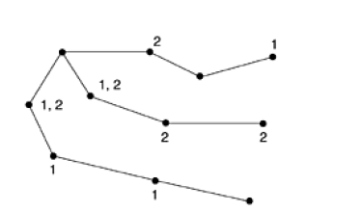
Network Topology Spanning Tree for left most node

Slide 39
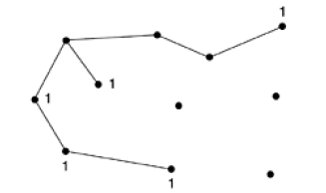
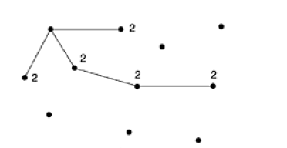
Route for group 1 Route for group 2

Slide 40
Removing all the lines that do no lead to hosts is called pruning
Method 1 : using link state routing
Method 2 : using distance vector routing
Basic Algorithm - Reverse path forwarding
A router with no hosts interested in particular group and no connections to other routers receive multicast message for that group, it responds with PRUNE message
Disadvantage : Scales poorly in large n/w
Storage - mn

Slide 41
Alternative design : Core based Trees
1993 – Ballardie
Single Spanning Tree per group is computed, with the root ( core ) near the middle of the group
To send multicast message, host sends it to core and core does multicast along the spanning tree
Storage - m

Slide 42
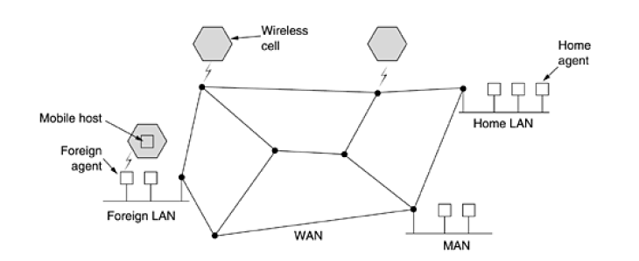
Routing for mobile hosts

Slide 43
3 types of hosts
host that never move – Stationary Host
host that move from one fixed site to another from time to time but use n/w only when they are physically connected to it – Migratory Host
host that compute on the run and want to maintain their connection as they move around – Roaming / Mobile Host

Slide 44
All hosts are assumed to have a permanent home location
Routing goal in systems with mobile hosts is to make it possible to send packets to mobile hosts using their home addresses and have packets efficiently reach them wherever they may be
Foreign Agents – processes that keep track of all mobile hosts visiting the area
Home Agents – keeps track of hosts whose home is in the area but who are currently visiting another area

Slide 45
Periodically, each foreign agent broadcasts a packet announcing its existence and address. A newly arrived mobile host may wait for one of these messages but if none arrives quickly enough, the mobile host can broadcast a packet saying: Are there any foreign agents around?
Mobile host registers with the foreign agent, giving its home address, current data link layer address and some security information

Slide 46
3. Foreign agent contacts the mobile host’s home agent and says: one of your hosts is over here. Message from foreign agent to the home agent contains the foreign agent’s n/w address. It also include security info to convince the home agent that the mobile host is really there.
4. Home agent examines the security info, which contains time stamp, to prove that it was generated within past few seconds. If it is happy, it tells foreign agent to proceed

Slide 47
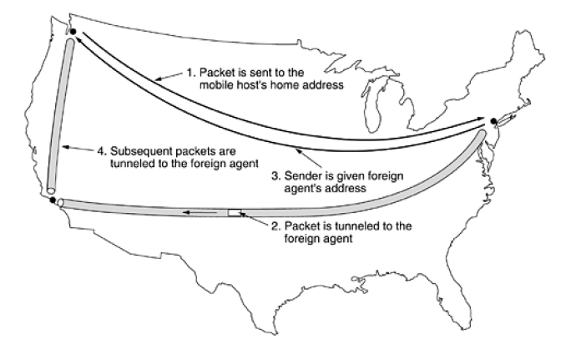
5. When foreign agent gets acknowledgement form home agent , it makes an entry in its tables and informs the mobile host that it is now registered

Slide 48
Routing in Ad – hoc network
Ad-hoc n/w = MANET (Mobile Ad-hoc N/w)
Routing algorithm = AODV
AODV = Ad-hoc on demand Distance Vector
Work in mobile environment and takes into account the limited bandwidth and low battery life
Determines route to some destination only when somebody want to send packet to that destination

Slide 49
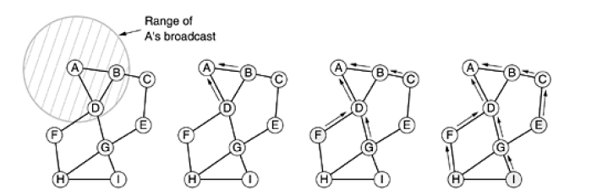
Route Discovery
Here, A want to send packet to I
A will broadcast ROUTE REQUEST packet

Slide 50

Source add, Request ID pair is looked up in local history table to see if this request has already been seen and processed.
If it is duplicate, it is discarded and processing stops
If it is not duplicate, pair is entered into the history table so future duplicates can be rejected and processing continues

Slide 51
2. Receiver looks up the destination in its route table.
If fresh route to the destination is known, ROUTE REPLY packet is sent back to source telling it how to get to destination
3. Since the receiver does not know a fresh route to the destination, it increments the hop count field and broadcast the ROUTE REQUEST packet.
It also extracts data from packet and stores it as new entry in its reverse route table
A times is also started for newly made reverse route entry. If it expires, the entry is deleted

Slide 52

ROUTE REPLY
At each intermediate node on the way back, packet is inspected.
It is entered into local routing table as route to destination if one of following three conditions are met:

Slide 53
No route to destination is known
The sequence number for destination in ROUTE REPLY packet is greater than the value in the routing table
The sequence numbers are equal but the new route is shorter
Number of broadcast can be reduced with the help of Time to Live
When TTL hits 0, packet is discarded instead of being broadcast

Slide 54
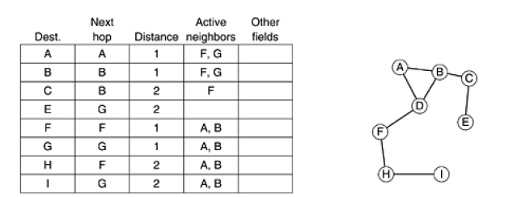
Route Maintenance
Hello message is used to know that neighbours are active or not. If node gets reply then neighbours are active otherwise not active
D’s routing table before G goes down Graph after G has gone down

Slide 55
Congestion control algorithms
When too many packets are present in subnet, performance degrades. This situation is called congestion
No of packets dumped into subnet by hosts is within its carrying capacity, they are all delivered
Relation: delivered packets are proportional to number of sent packets

Slide 56
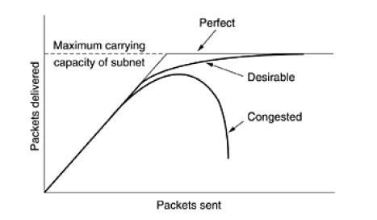

Slide 57
Principles of congestion control
Open Loop
Attempt to solve problem by good design
Once system is up and running, midcourse corrections are not made
Decide when to accept traffic, discard packets, scheduling decisions
Closed Loop
Solutions are based on feedback loop
Monitor system to detect when and where congestion occurs
Pass this info to places where action can be taken
Adjust system operation to correct problem

Slide 58
Yang & Reddy have developed taxonomy for congestion control algorithms – 1995
Begin to divide algo in open and closed loop
Further divide open loop into one that act at source versus one that act at destination
Closed loop also divided into two: explicit feedback versus implicit feedback

Slide 59
In explicit feedback algo, packets are sent back from point of congestion to warn the source
In implicit feedback algo, source deduces the existence of congestion by making local observations
Presence of congestion means that load is greater than the resources can handle
Two solutions
Increase the resources
Decrease the load

Slide 60
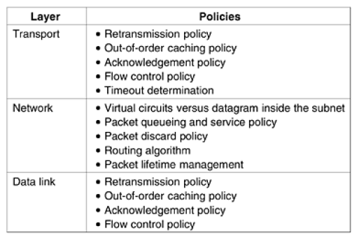
Congestion prevention policies
Policies that affect congestion
in
Open loop

Slide 61
Congestion control in virtual-circuit subnet
Technique 1: Admission Control
Once congestion has been signalled, no more virtual circuits are set up until the problem has gone away

Slide 62
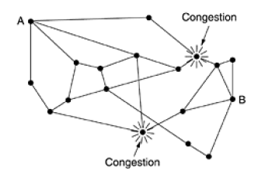
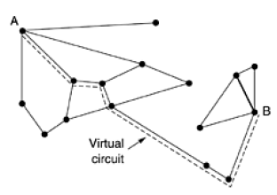
Congested Subnet Redrawn subnet that eliminates congestion

Slide 63
Technique 2:
To negotiate an agreement between host and subnet when a virtual circuit is set up
Congestion is unlikely to occur on the new virtual circuits because all the necessary resources are guaranteed to be available
Disadvantage – it tends to waste resources

Slide 64
Congestion control in datagram subnet
Each router can easily monitor the utilization of its output lines and other resources
U = reflects recent utilization of that line
value – between 0.0 and 1.0
To maintain good estimate of u, a sample of instantaneous line utilization, f (either 0 or 1) can be made periodically and u updated according to
A = determines how fast router forgets recent history

Slide 65
Whenever u moves above the threshold, output line enters a warning state
If it enters warning state, some action is taken
Warning Bit
DECNET architecture signalled the warning state by setting a special bit in packet’s header
When packet arrived at its destination, the transport entity copied bit into next acknowledgement sent back to the source
Source then cut back on traffic

Slide 66
Choke Packets
In this approach, the router sends a choke packet back to source host, giving it the destination found in the packet
When source gets chock packet, it is required to reduce the traffic sent to specified destination by x percent

Slide 67
Hop by hop choke packets
At high speeds or long distance, sending choke packet to source hosts does not work well because the reaction is so slow
At each hop, flow should be slow down so that congestion control can be done effectively and efficiently

Slide 68
Load shedding
Load shedding is a fancy way of saying that when routers are being inundated by packets that they can not handle, they just throw them away
Which packet to discard?
some app older is more important
in multimedia, new one is more important

Slide 69
Random Early Detection (RED)
1993 – Floyd and Jacobson
In some transport protocols, response to lost packets is for the source to slow down
By having routers to drop packets before the situation has become hopeless, idea is that there is time for action to be taken before it is too late
To determine when to start discarding, routers maintain running average of their queue lengths

Slide 70
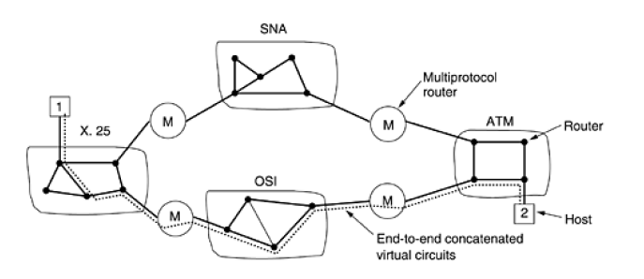
Virtual circuits

Slide 71
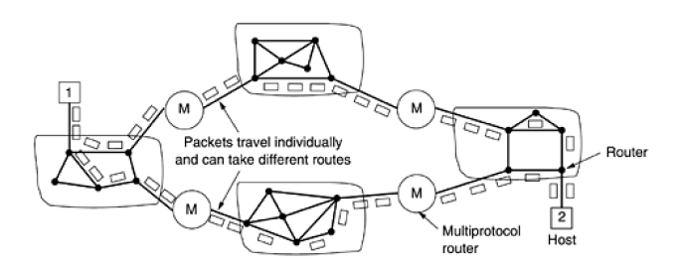
Connectionless internetworking

Slide 72
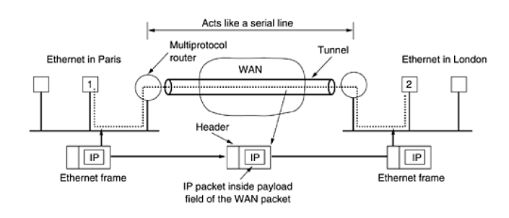
tunneling

Slide 73
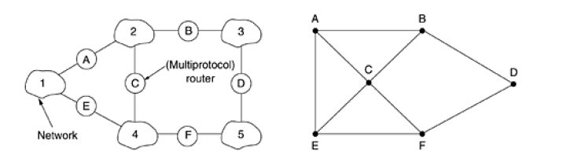
Internetwork routing
Internetwork Graph of internetwork
Interior gateway protocol & Exterior Gateway Protocol

Slide 74
fragmentation
When large size of packet is required to send from source to destination,
Gateways break up packets into fragments, sending each as a separate internet packet
To breaking up in fragments is an easy task but at the receiver side to recover the original packet or message is hard

Slide 75
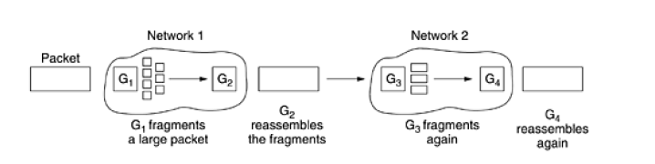
Method1: Transparent fragmentation

Slide 76
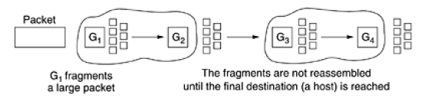
Method 2 : Non transparent fragmentation

Slide 77
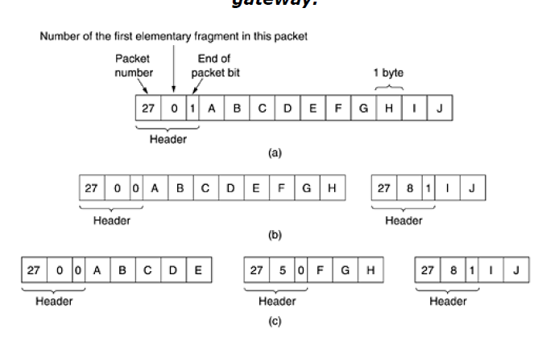

Slide 78
N/w layer in the Internet
Some principles :
Make sure it works
Keep it simple
Make clear choices
Exploit modularity
Expect heterogeneity
Avoid static options and parameters
Look for a good design, it need to be perfect
Be strict when sending and tolerant when receiving
Think about scalability
Consider performance and cost

Slide 79
IP Protocol
IP datagram consists of header part and text part
Header has 20byte fixed part and variable length optional part
Version field - version information of protocol
As header length is not constant, a field in the header IHL is provided to tell how long the header is in 32 bit words
Type of service field - 6bit field contained,3 bit precedence field and 3flags - D,T, R
Precedence field was a priority - 0 to 7

Slide 80
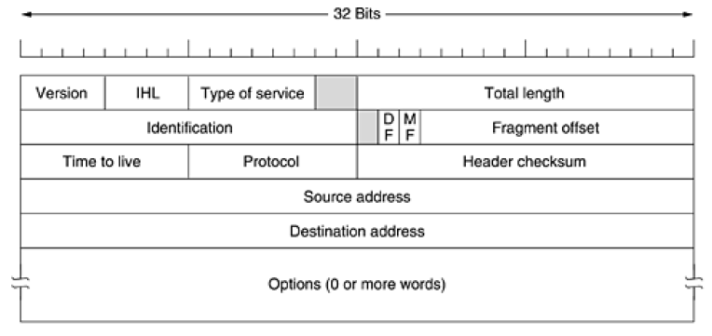

Slide 81
Total length - includes header and data
Maximum length is 65535 bytes
Identification - to allow destination host to determine which datagram newly arrived fragment belongs to
All the fragments of datagram contain same identification value
Next bit is unused bit and other 2 - 1 bit fields
DF – don’t fragment MF - more fragments
Note: all machines are required to accept fragments of 576 bytes or less

Slide 82
Fragment offset - where in current datagram this fragment belongs
Note: all fragments except the last one in datagram must be a multiple of 8 bytes
Time to live field - counter used to limit packet lifetimes
Maximum lifetime is 255 sec
Protocol field - tells which transport process to give it to
Header checksum - verifies the header only
Source address and destination address indicate the network number and host number

Slide 83
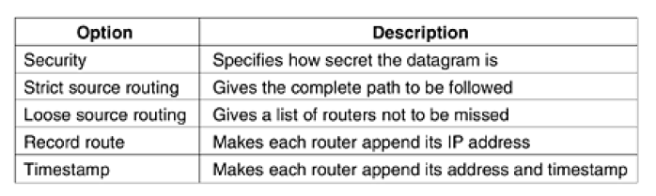
Option Field

Slide 84
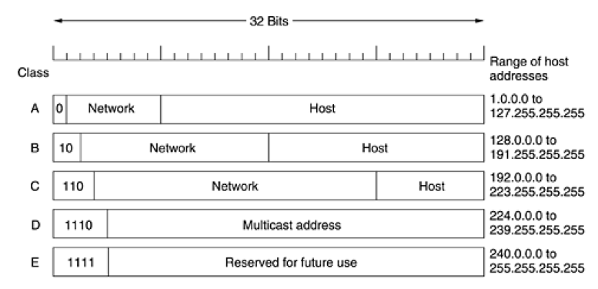
IP Addresses

Slide 85
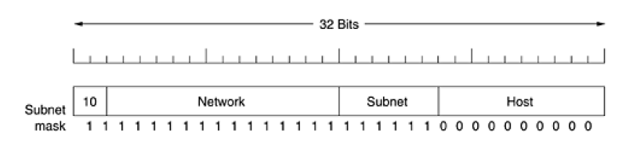
Subnet :

Slide 86
CIDR - Classless Inter Domain Routing
Each routing table entry is extended by giving it 32 bit mask
Single routing table for all networks consisting of an array of triples
IP address, Subnet Mask and outgoing line
If multiples entries in table then consider longest mask
NAT - Network Address Translation
When session is terminated, IP address is re-assigned to other user

Slide 87
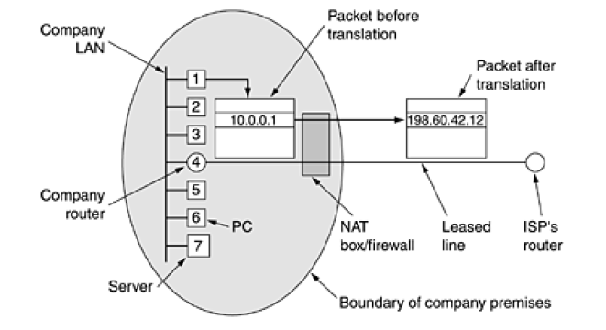

Slide 88
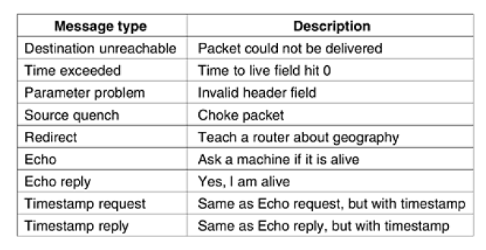
ICMP - Internet Control Message Protocol
To test internet

Slide 89
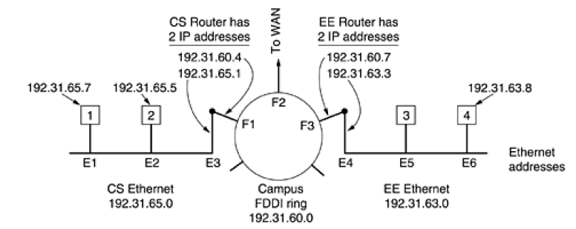
ARP - Address Resolution Protocol
To map ip address at data link layer
Broadcast message at data link layer to know the hop having same ip address

Slide 90
RARP - Reverse Address Resolution Protocol
Used for newly booted workstation
To know its ip address as it knows only its data link address
Disadvantage - such broadcast is not forwarded by routers
Alternate solution is BOOTSTARP

Slide 91
BOOTP - Bootstrap Protocol
Uses UDP messages
Forwarded over routers
Also provide information about default router and subnet mask to use
Disadvantage - it requires manual configuration of tables mapping IP address to Ethernet address
Solution - DHCP

